Slide 1
Workshop: Relativity Forms API

Slide 3



Kevin Opperman
Adam Sorna
Keith Kaminski
Justin Dougherty
Notes:
Good morning everyone, my name is Justin Dougherty and I am a product manger at Relativity. I have the pleasure of being joined by three masters of engineering Kevin Opperman, Adam Sorna, and Keith Kaminski.

Slide 4
Course Overview
Setting Up Your Machine
Example Relativity Application
Customize Objects with Relativity Forms
Enabling Relativity Forms
Writing Relativity Forms Event Handlers
Reading and Manipulating Fields
Generating Markup
Calling APIs
Notes:
Talking about RF in the context of the conversion of an app
First we'll set the environment
Then we'll describe and use the app before conversion
Begin customization by enabling RF
Dive deeper by actually writing the JavaScript handlers

Slide 5
Enhance Relativity development skills
Interest you in our new technology (which excites us)
Why are we doing this workshop?
Notes:
Inform you about RF – new rendering engine, prepare for eventual switch
Most heavily JavaScript - .NET audience – exercises tailored accordingly

Slide 6
Getting Started

Slide 7
Username: .\relsvc
Password: InfraTraining1!
Workshop Environment LogIn

Slide 8
Projects and Workbook
Follow instructions on Section 2.1 to access the various projects that will be used in the workshop.
Make sure to open the updated workbook document
You have about 5 minutes to complete these instructions.
Workshop Projects,
Updated Workbook
And
DevVm Setup
DevVm Setup
Follow instructions in Section 2.2 to set up DevVm for accessing Relativity.
You have about 10 minutes to set up your DevVm.

Slide 9
Example Relativity Application

Slide 10
Application tracks a person's enthusiasm levels
Person Object Type
Event Handlers
Kepler Service
Application development halted before completion of Console EventHandler to migrate to Relativity Forms
Example
Relativity
Application
Notes:
We will look at this application in Exercise 1 and begin to modify it

Slide 11
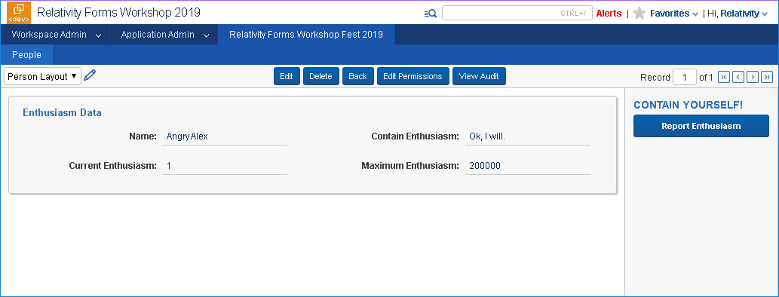
Example Relativity Application

Slide 12
Customizing Object Types
With Relativity Forms

Slide 13
Enabling Relativity Forms
You will have about 10 minutes to complete Exercise 1 (Workbook Section 3.2)
Effect of enabling Relativity Forms
Customizing Object Types
Customizing Relativity Forms
You will have about 20 minutes to complete Exercise 2
Updating Page Interaction EventHandler
(Using Template Project Automation)

Slide 14
Writing Event Handlers
Relativity Forms JavaScript

Slide 15
Page Interaction
Pipelines
Reading/manipulating fields
Reacting to change
You will have about 25 minutes to complete Exercise 3
Writing Event Handlers
Console and Calling Kepler APIs
You will have about 25 minutes to complete Exercise 4
Populating Console
Kepler calls with relativityHttpClient

Slide 16
Questions?

Slide 17
Platform Documentation: https://platform.relativity.com/RelativityOne/ Relativity Forms: https://platform.relativity.com/RelativityOne/Content/Relativity_Forms/Relativity_Forms_API.htm
Relativity Forms Cheat Sheet: https://github.com/relativitydev/relativity-forms-workshop-fest-2019/raw/master/docs/workshop/Relativity%20Forms%20Cheat%20Sheet.pdf
DevHelp: https://devhelp.relativity.com/c/relativityui/relativityforms Category: RelativityUI Sub-Category: RelativityForms
This Workshop's Materials on GitHub: https://github.com/relativitydev/relativity-forms-workshop-fest-2019
Feedback: RelativityFormsFeedback@relativity.com

